Slide 1
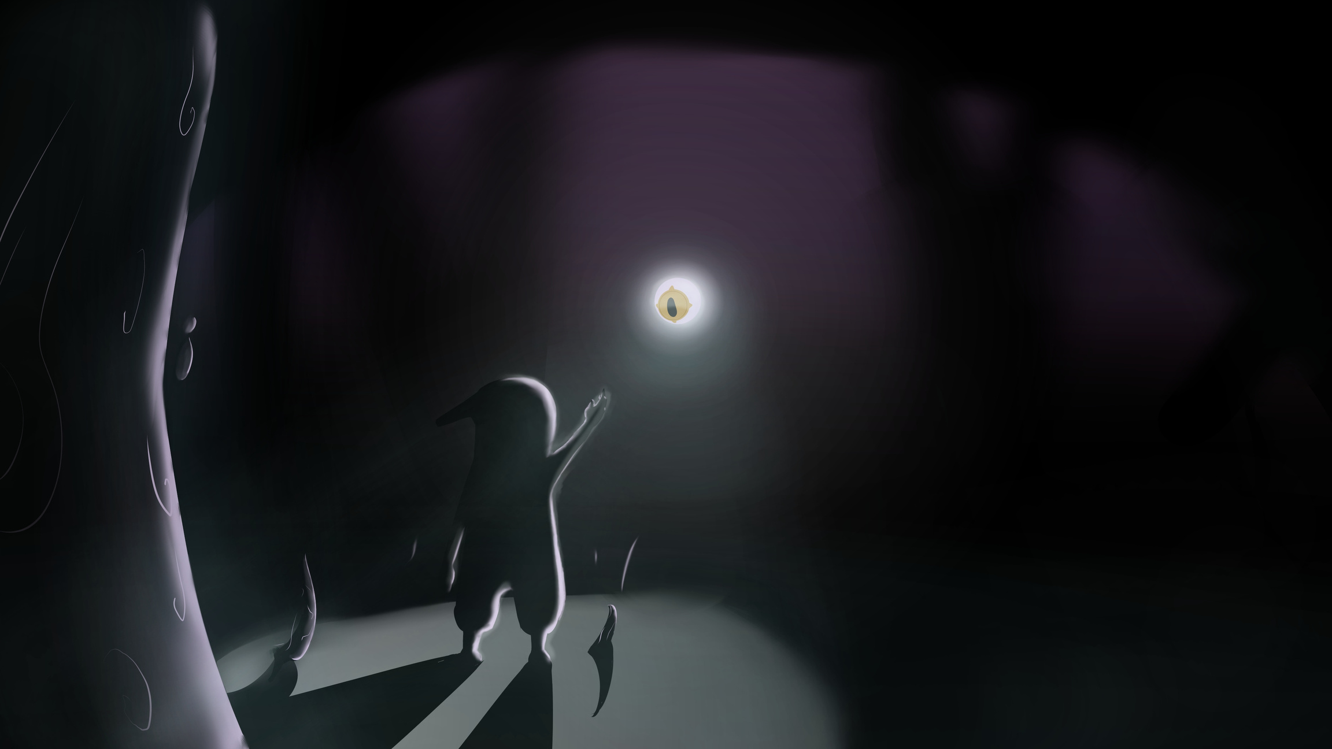



Shadow & Eye
What if the human mind was a deep, intricate eco-system, with every aspect having a physical form and the hard fought battles inside will take place right in-front of your eyes?
Shadow & Eye is a 2D Metroidvania where not only do you fight inner demons, but you ARM yourself with them.

Slide 2
the team
Computer Science Department
Animation Department
Or Bar - Califa
Daniel Tselon Fardkin
Naor Masri
Majd Francis
Programming & Game Development VFX
Conceptual Dev
Characters
Background Environment Art
Mentoring by Ella Luna Pleasence

Slide 3

The concept
As a disaster falls upon this world, at you feet arrives “The Eye” - an all-seeing entity, removed and banished from its place.
your mission is to return it to its place and bring this world back to health.
In order to traverse this unforgiving land, The Eye grants you the power to wear the shells of the enemies you defeat - ”Maluvestis”, to beat even stronger foes and reach remarkable hights.
Genre & Loop: 2D platformer → explore → combat → unlock suits → overcome challenges

Slide 4

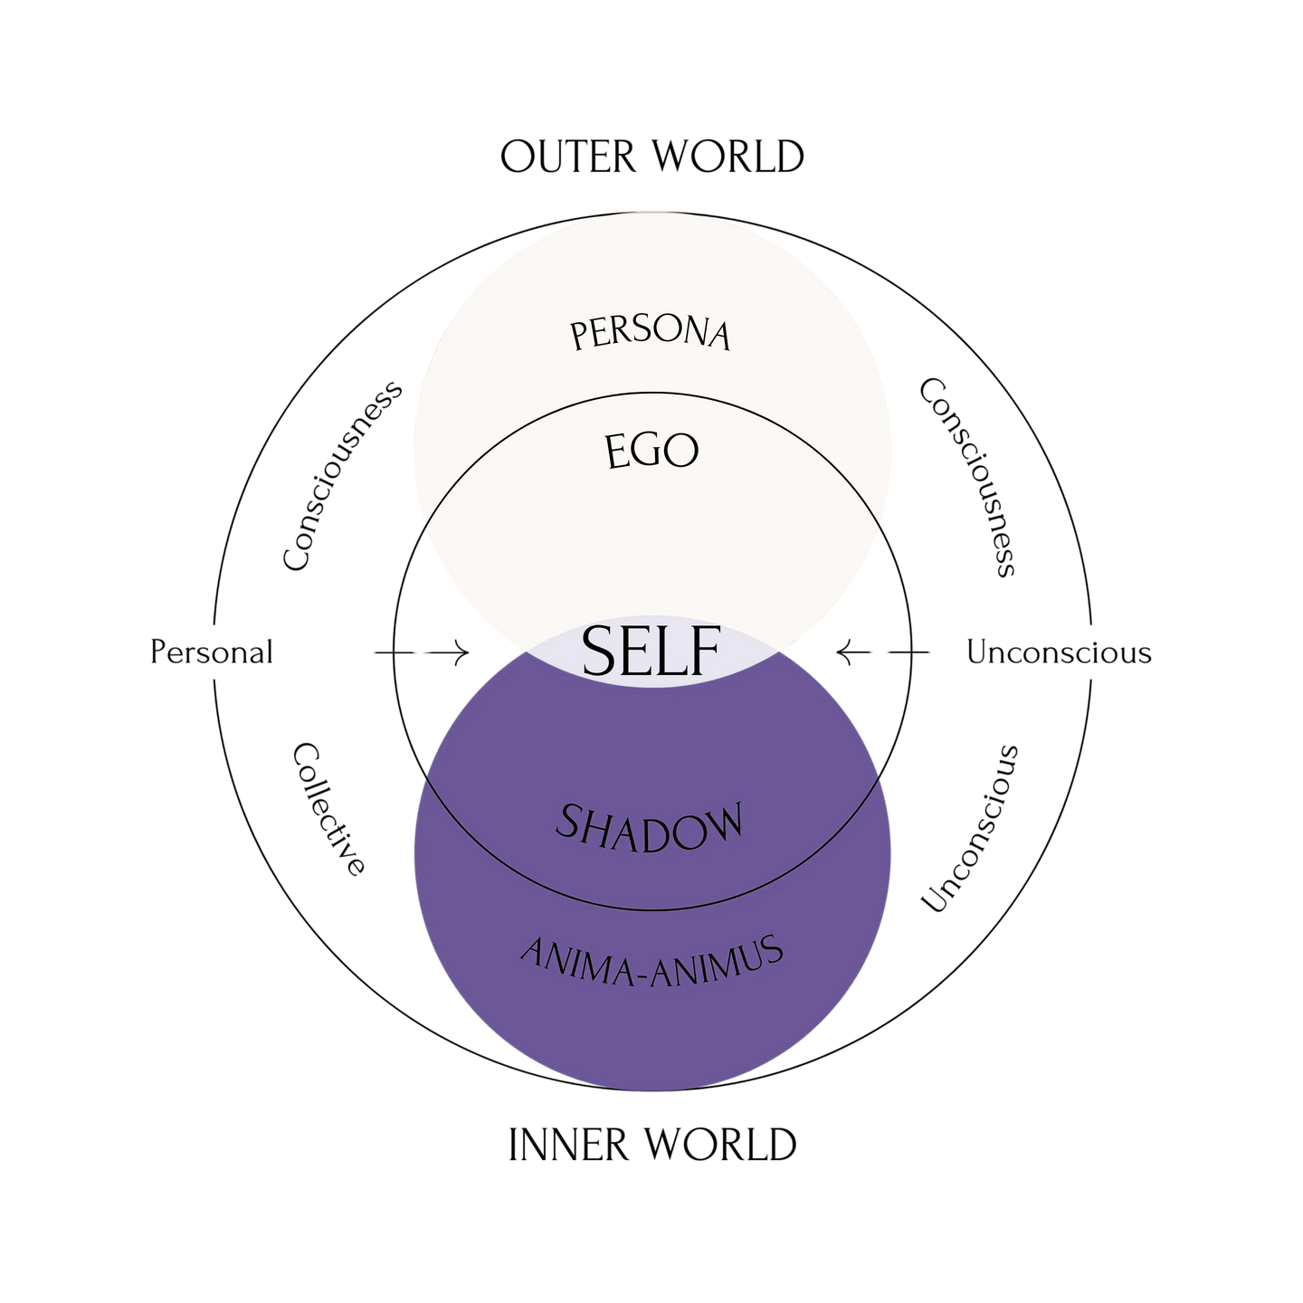



The Theory
THE game
REVELIS
VERONA
VEGO
THE EYE
ADO
EBBA & IMMUS
CALIGOTH

Slide 5
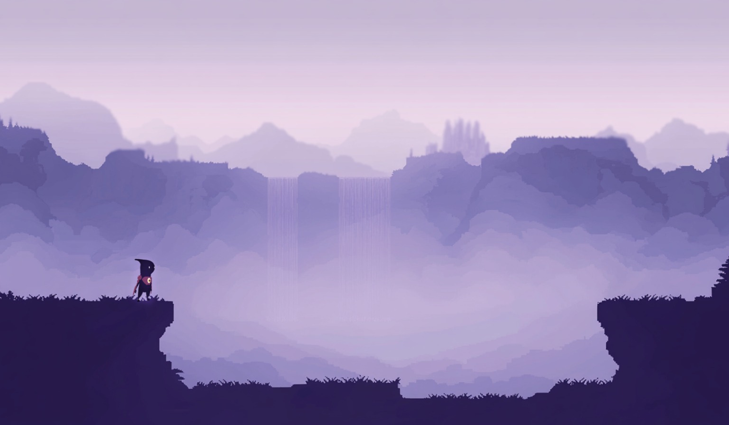
ı
ıı
Project Goals
Fun game exploring self-discovery & inner challenges
Support variety of abilities to allow diverse playstyles
Smooth Combat & Movement: Impactful actions; fluid tactical adaptation; dynamic movement
Support expandability and maintainability of large scaled game with different levels and challenges

Slide 6
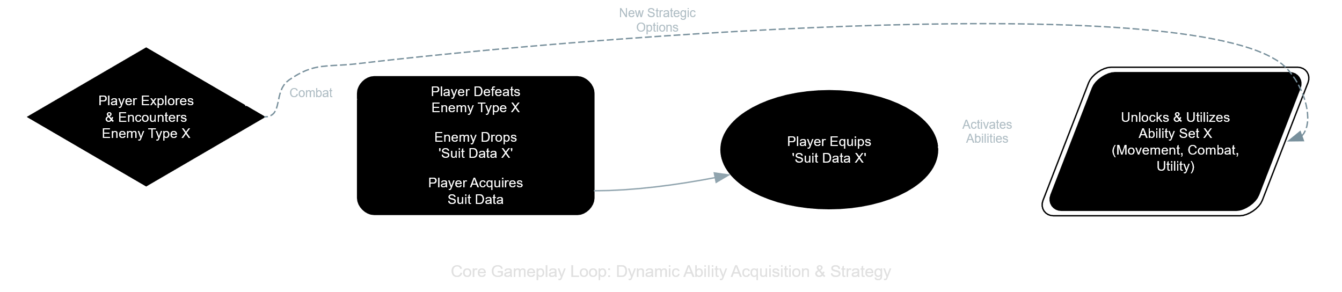
Making it All Happen
Dynamic world with many different levels
Diverse suits and abilities: Handle different kinds of abilities and suits
Quick Power Swaps: Adjust player functionality based on equipped suit.
Create distinct behavior for each enemy.
System Interplay: Independent yet coordinated game parts.
[IMAGE: A question mark icon or a lightbulb icon]
Notes:
Speaker Notes: (You'll deliver this verbally) Of course, we hit some challenges. Like, how do we manage all these unique player powers without the code getting super messy? How do we make switching between powers feel good? How do we make sure the game mechanics actually connect to our deeper themes? And how do we get all the different parts of the game to talk to each other without creating a tangled web?

Slide 7
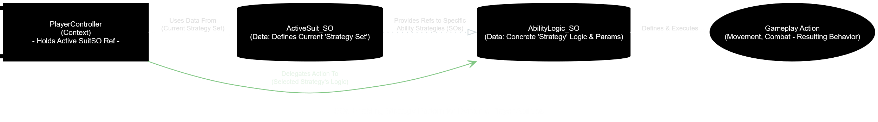
How We Solved It (Part 1): Smart Data & Key Patterns
Foundation: Component-Based Unity development.
#1: ScriptableObjects (SOs) - Data-Driven Design:
Suites and abilities defined as data files (SOs).
New Suit = New Data, not new complex code.
Benefit: Flexible, easy iteration, thematic integration.
#2: Strategy Pattern (Player Powers):
Player swaps "game plans" (power sets) from absorbed essences.
Benefit: Fluid playstyle changes.
Notes:
Speaker Notes: (You'll deliver this verbally) So here's how we tackled those challenges. Our main trick was using ScriptableObjects a LOT. Think of these as data files that tell the game how abilities work or how enemies should behave. This means adding a new power is mostly like adding a new data file, not rewriting a bunch of code. For player powers, we used the Strategy pattern – which just means the player can easily swap their 'game plan' based on the enemy power they're using.

Slide 8
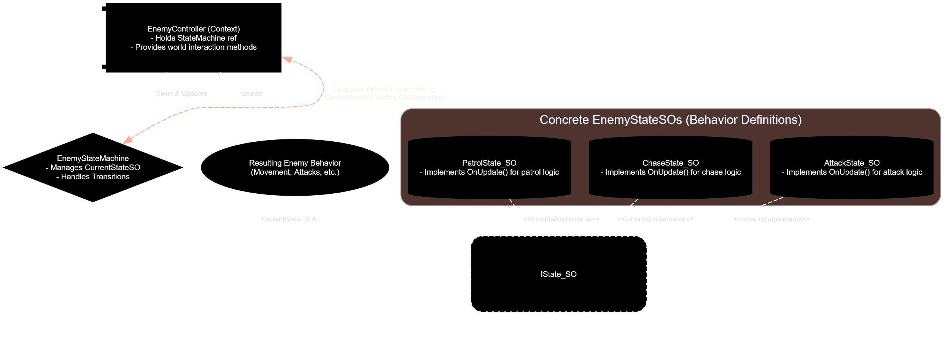
How We Solved It (Part 2): System Flow & Communication
#3: State Pattern (Enemy AI & Game Flow):
Enemies: Clear behavior states (idle, chase, attack).
Game: Defined states (menu, playing, paused).
Benefit: Organized, debuggable complex behaviors.
#4: Observer Pattern (SO Event Channels - "Notice Board"):
Event happens (player hit) -> posts "notice" (SO Event).
Other systems (UI, sound) react if interested. No direct links.
Benefit: Decoupled systems, cleaner code, maintainable.
Key Tech: URP (visuals), A* Pathfinding (enemy nav).
Notes:
Speaker Notes: (You'll deliver this verbally) Enemies and the game's flow use the State pattern, which keeps their behaviors organized. And for getting different systems to communicate, we used ScriptableObject Event Channels – it's like a digital notice board. When something happens, a notice gets posted, and any system that cares can react. This keeps everything nicely separated. Plus, URP helped us make the different 'mind-zones' look cool, and A* makes enemies chase you properly.

Slide 9
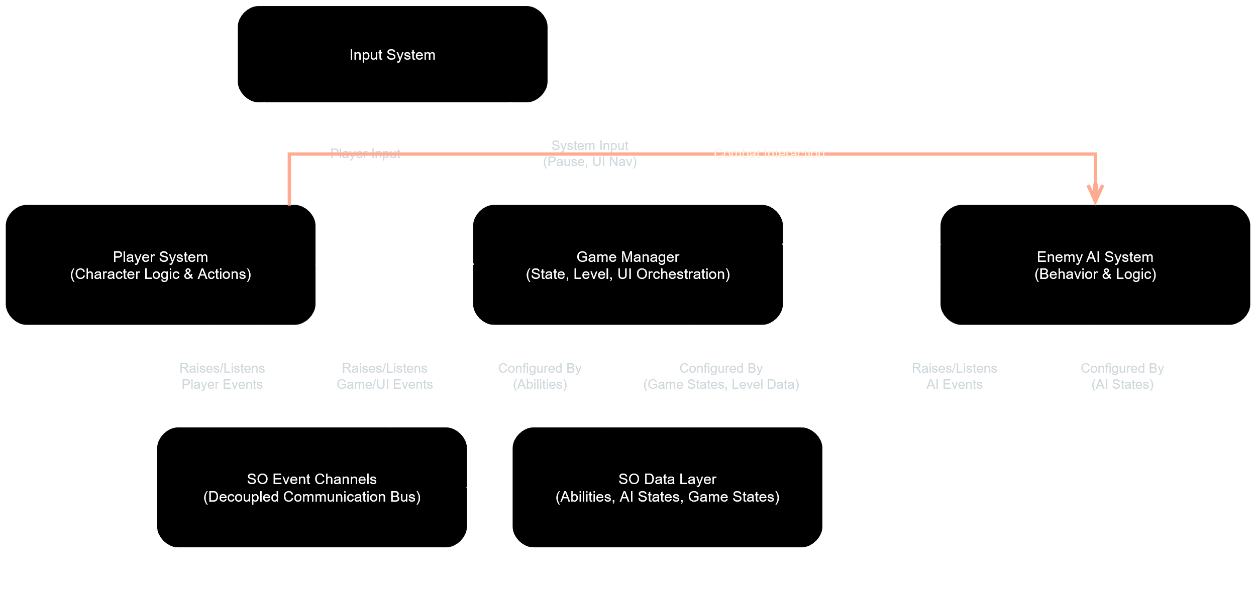
So, Did Our Plan Work?
[IMAGE/GIF: Short GIF showing off a few different cool powers in action]
Added 3 diverse powers; minimal core changes.
Smooth performance and game feel.
Decoupled system: easier debugging & additions.
Notes:
Speaker Notes: (You'll deliver this verbally) And yeah, this approach worked out pretty well! We were able to add a bunch of unique player abilities without massive headaches, the game runs smoothly, and because our code is organized, fixing things and adding features has been manageable.

Slide 10
The Coolest Part & What's Next
Proudest Of: Deep ideas linked to gameplay via flexible, data-driven design.
Future: More powers, crazier "demons," expanded world, finish story.
[IMAGE: An exciting in-game shot or a piece of concept art hinting at future areas]
Notes:
Speaker Notes: (You'll deliver this verbally) What we're most proud of is how the game's deep ideas are built right into the gameplay, thanks to our flexible, data-driven systems. For the future, we'd love to add more powers, crazier enemies, new areas of the mind-world to explore, and wrap up the story.

Slide 11
Questions?
Team: Naor, Majd, Daniel, Or [TEXT: Your Portfolio/Project Link (Optional)]
[IMAGE: "Shadow & Eye" logo]
Notes:
Speaker Notes: (You'll deliver this verbally) Thanks for listening! Any questions?

Slide 12
Technology
Algorithms
Unity engine and tools:
unity engine provide physics and the basic enviorment
A* Project - to provide points and paths
cinemachine- To create a dynamic camera according to size of room
enemy Ai useing state machine to give diffrent and smarter behivors
new input system for a wild range of controllers
Tech Stack: Unity (2022 LTS), C#, URP, Input System, A* Pathfinding.
A* Project - to provide points and paths
enemy Ai useing state machine to give diffrent and smarter behivors

Slide 13
Architecture
InputSystem
singletons for managers like level manager
state machine that handles events and updates based on player input and actions using state pattrn
beacon using mediator pattern to prevent dependencies and reduce capaling
dedicated scripts for specific action to provide a clear structure and orignition
event based architecture to reduce capulin
using abstract classes to facilitate generic interfaces
Loose coupling via ScriptableObject events
[InputSystem] → [MovementModule] → [PhysicsEngine]
↘ ↗
[SuitManager] ↔ [CombatModule] → [Animator]
↘ ↗
[EnemyAI (FSM + ML-Agents)]

